Slide 1
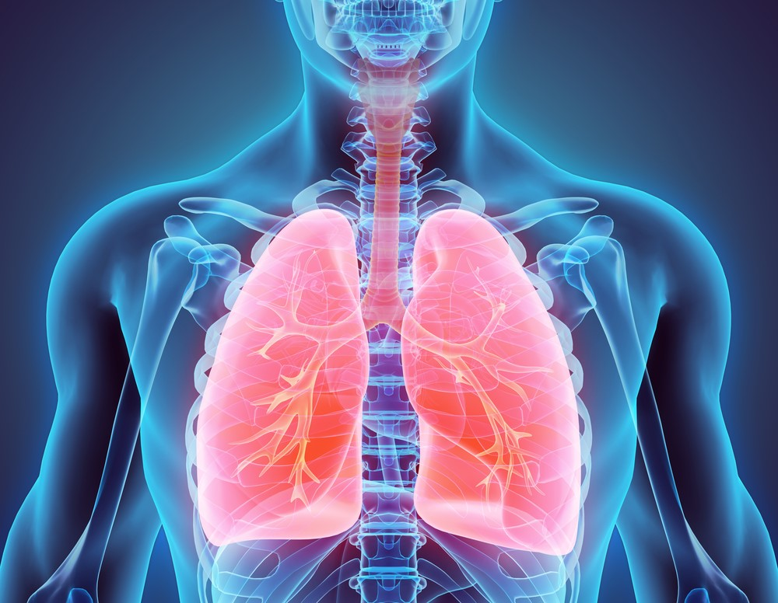
Pneumonia Detection using CNN Abhishek Saha Msc DSBDA

Slide 2
INTRODUCTION
Pneumonia is an inflammatory lung disease characterized by multiple illnesses caused by different microorganisms
Early detection and diagnosis of pneumonia is critical for effective treatment and prevention of complications
Medical imaging i.e. chest X-rays, is often used for the diagnosis of pneumonia
Pneumonia is a common respiratory infection, affecting approximately 450 million people a year

Slide 3
MOTIVATION
To address the challenges in diagnosing pneumonia which is a leading cause of morbidity and mortality worldwide
Manual interpretation of chest X-ray images can be challenging and time-consuming
Development of automated pneumonia detection systems using deep learning to assist radiologists in their diagnosis and improve the accuracy and speed of diagnosis

Slide 4



Tools used in this are Python, Open cv, Keras, CNN, Matplotlib
Data is extracted from Mayo Clinic website
It contains 1371 normal lung images of X-ray & 3875 pneumonia infected images

Slide 5
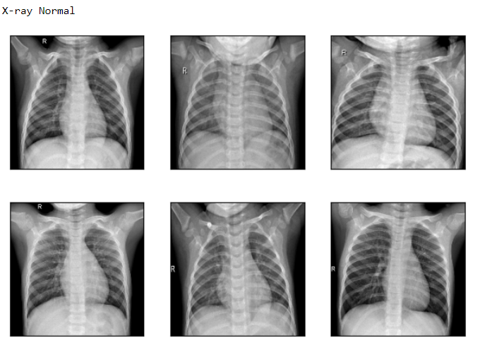
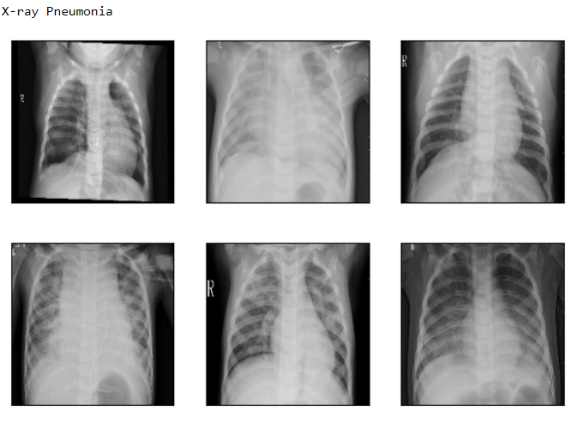
Training Dataset

Slide 6
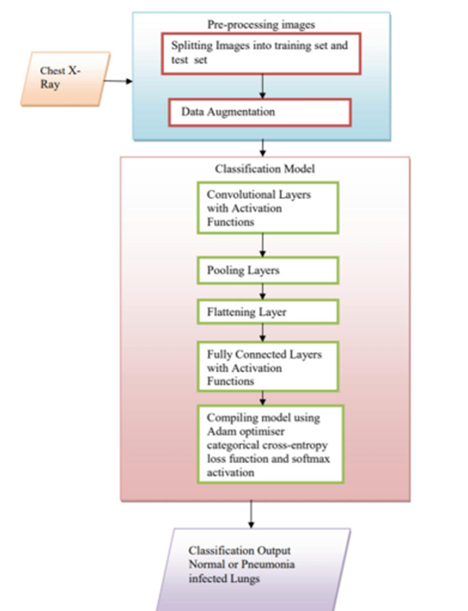
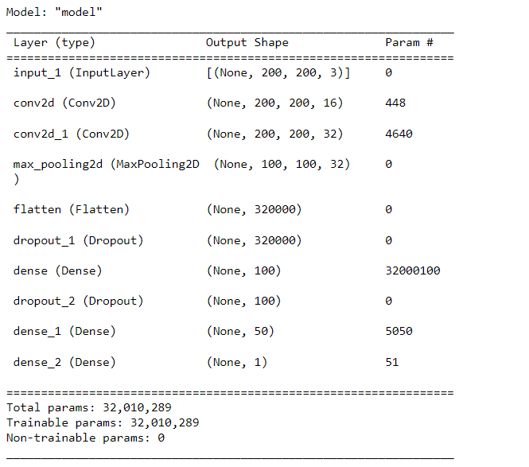
Model Design

Slide 7
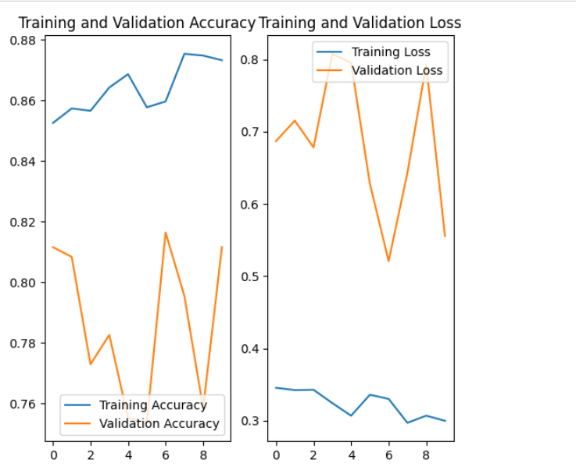
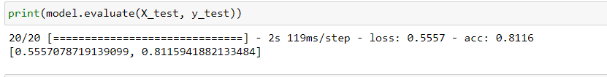
Model Accuracy

Slide 8
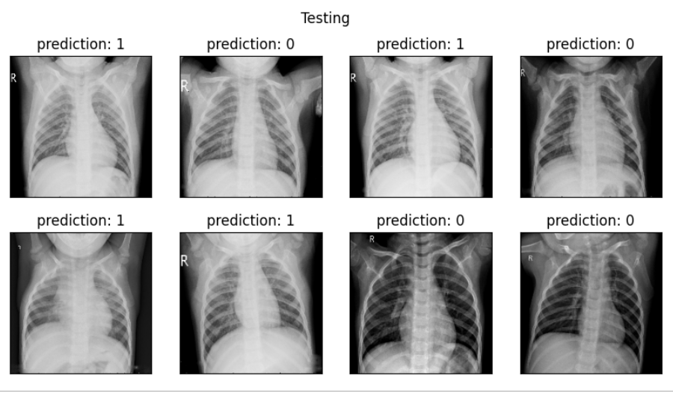
Testing

Slide 9
FUTURE WORK
Build a multi-class classification model to distinguish between Normal, Viral Pneumonia, and Bacterial Pneumonia
Combine CNN models with other classifiers such as Support Vector Machine
Tune parameters such as learning rate, batch size, number of layers, types of layer, number of neurons per layer, and the type of activation functions for each layer by GridSearchCV or Randomized SearchSV.

